Slide 1

Flight Delay Prediction Using Machine Learning
Name: N. Dasaratha Reddy
Roll No : 21691A0528
4th Year
CSE-A

Slide 2
Agenda
Project Overview
Introduction
Dataset Overview
Methodology
About the Domain
Algorithms Used
Results and Insights
Conclusion
Future Scope
References

Slide 3

PROJECT OVERVIEW
This project aims to predict flight delays using a Kaggle dataset containing comprehensive flight information such as departure and arrival times, airline carriers, and airport details. The primary objective is to build an accurate predictive model that helps understand patterns and causes of delays in the U.S. domestic flight network.
Various machine learning models were implemented, including Linear Regression, Random Forest, and Boosted Regression. Both regression and classification approaches were evaluated using metrics like MAE, RMSE, R², Precision, Recall, and F1 Score. Among the models tested, Random Forest delivered high accuracy, making it effective for identifying significant factors contributing to flight delays.

Slide 4

INTRODUCTION
In today's world, time is money. Flight delays inconvenience passengers, disrupt airline operations, and lead to financial losses for airports and carriers. Predicting flight delays can help passengers plan better, avoid missed connections or meetings, and reduce stress. This project aims to build machine learning models to accurately predict flight delays based on features such as the airline, route, distance, and departure schedule.
The objective is to perform an in-depth analysis of the dataset, evaluate how different features impact prediction accuracy, and compare multiple machine learning models. Due to the complex and stochastic nature of air transport systems, building robust models is a challenging but worthwhile endeavor.

Slide 5

DATASET OVERVIEW
Link: https://www.kaggle.com/datasets/usdot/flight-delays/data
The dataset is provided by the US Department of Transportation (USDOT) and is available on Kaggle. It contains historical flight data on delays and cancellations in the United States.
Here we are using 3 types of .csv Files.
airlines.csv: Contains 2 of 2 columns and it contains IATA airline codes and names.
airports.csv: Contains 7 of 7 columns and it contains IATA codes, airport’s name, city, state, country, latitude and longitude.
flights.csv: Contains 31 of 31 columns and it contains year, month, day, day of week, airline identifier, flight number and so on.

Slide 6
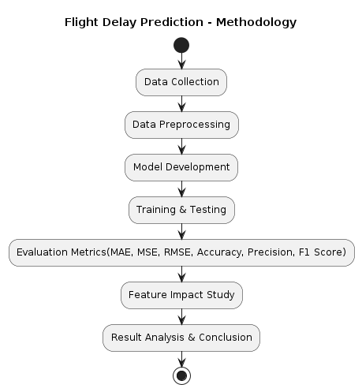
METHODOLOGY
Data Collection: Collect flight data from Kaggle including airline, origin, destination, and delay information.
Data Preprocessing: Clean and prepare data by handling missing values, encoding categorical features, and normalizing numerical values.
Model Development: Develop regression (Linear, Random Forest, MLP) and classification (KNN, Logistic Regression, Decision Tree) models.
Training & Testing: Split the data into 80% training and 20% testing sets and train/test the models accordingly.
Evaluation Metrics: Evaluate model performance using MAE, MSE, RMSE, accuracy, precision, recall, and F1 score.
Feature Impact Study: Analyze the impact of key features, such as 'departure delay', on model performance.
Result Analysis & Conclusion: Analyze results to identify the best models and suggest future improvements for the system.

Slide 7
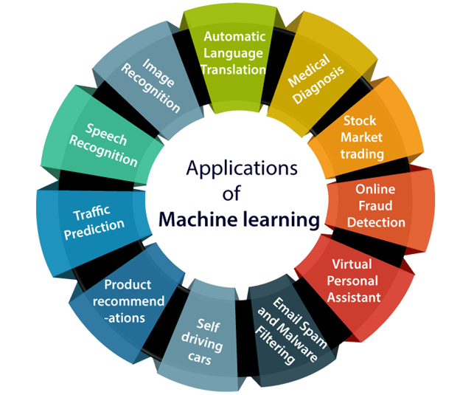
ABOUT THE DOMAIN
Machine Learning (ML) is a subset of artificial intelligence that allows systems to learn from data and improve over time. It helps predict outcomes and recognize patterns without explicit programming. In the context of flight delay prediction, ML algorithms analyze historical data such as weather conditions, air traffic, and past delays to make accurate real-time predictions.
ML models, like Random Forests and Neural Networks, excel at handling complex, non-linear relationships between multiple variables. This ability enables more precise predictions about delays caused by factors like weather disruptions, airport congestion, or flight scheduling. By predicting delays accurately, airlines can optimize schedules, improve customer satisfaction, and reduce operational costs.

Slide 8

ALGORITHMS USED
Linear Regression
Random Forest
Boosted Linear Regression
MLP Regressor (Multi-layer Perceptron)

Slide 9
ABOUT LINEAR REGRESSION
Linear Regression
Linear Regression is a supervised learning algorithm that models the relationship between input variables and a continuous target by fitting a straight line.
It predicts the expected flight delay time based on features like scheduled departure, airline, and distance.
In our project, it is used to estimate flight delays and evaluate how well the linear trend captures the variations in delay.
Metrics Used:
MAE (Mean Absolute Error): Measures the average magnitude of errors in predictions, without considering their direction.
MSE (Mean Squared Error): Squares the errors to penalize larger deviations more heavily.
RMSE (Root Mean Squared Error): The square root of MSE, interpretable in the same units as the target variable.
R² Score (Coefficient of Determination): Indicates how well the independent variables explain the variation in the dependent variable.

Slide 10
ABOUT RANDOM FOREST
Random Forest
Random Forest is an ensemble learning method that builds multiple decision trees and combines their outputs for more accurate and stable predictions.
It handles both regression and classification tasks and reduces overfitting by averaging the results of many trees.
In our project, Random Forest is used to predict flight delays more robustly by capturing complex, non-linear relationships between flight features.
Metrics Used:
MAE (Mean Absolute Error): Helps understand the average error in predicted delay time.
MSE (Mean Squared Error): Emphasizes larger errors and is useful for optimization.
RMSE (Root Mean Squared Error): Indicates prediction error magnitude in real units (minutes).
R² Score: Shows how well the ensemble model explains the variability in delay outcomes.

Slide 11
ABOUT BOOSTED LINEAR REGRESSION
Boosted Linear Regression
Boosted Linear Regression is an ensemble method where multiple weak linear models are combined sequentially to form a stronger predictive model.
Each new model tries to correct the errors made by the previous one, improving overall performance with each iteration.
In our project, it enhances the basic linear regression model's accuracy in predicting flight delays by focusing on harder-to-predict cases.
Metrics Used:
MAE (Mean Absolute Error): Measures the average magnitude of prediction errors.
MSE (Mean Squared Error): Captures how large the errors are, squaring them to penalize larger deviations.
RMSE (Root Mean Squared Error): Helps interpret the average error in terms of actual delay minutes.
R² Score: Evaluates how well the boosted model fits the flight delay data.

Slide 12
ABOUT MLP REGRESSOR
MLP Regressor (Multi-Layer Perceptron Regressor)
MLP Regressor is a type of neural network that consists of input, hidden, and output layers, capable of learning complex nonlinear relationships in the data.
It uses back propagation to minimize error and improve prediction accuracy across multiple layers of computation.
In our project, it helps model the nonlinear patterns between flight features and delays, leading to more accurate delay predictions.
Metrics Used:
MAE (Mean Absolute Error): Shows the average difference between actual and predicted delays.
MSE (Mean Squared Error): Emphasizes larger errors by squaring the differences.
RMSE (Root Mean Squared Error): Makes the error scale interpretable in the same units as delay.
R² Score: Tells us how well the model captures the variance in the flight delay data.

Slide 13
RESULTS AND INSIGHTS
Model | Type | MAE | MSE | RMSE | R² Score | F1 Score | Precision | Recall | Accuracy
Linear Regression | Regression | 0.0000015 | 0.0000031 | 0.00175 | 0.99999 | – | – | – | –
Random Forest Regressor | Regression | 0.6129 | 4.127 | 2.0315 | 0.9974 | – | – | – | –
Decision Tree Regressor | Regression | 21.26 | 1619.6 | 40.24 | 0.16 | – | – | – | –
Boosted Linear Regression | Regression | 0.0000015 | 0.0000031 | 0.00175 | 0.99999 | – | – | – | –
MLP Regressor | Regression | 18 | 1376 | 37 | ~0.0 | – | – | – | –
Logistic Regression | Classification | – | – | – | – | 1.0 | 1.0 | 1.0 | 1.0
K-Nearest Neighbors | Classification | – | – | – | – | 0 | 0 | 0 | 0
Decision Tree Classifier | Classification | – | – | – | – | 0 | 0 | 0 | 0
Linear Regression outperformed all regression models with nearly perfect R² and lowest error values.
Logistic Regression gave perfect classification results after applying SMOTE to balance the dataset.
Removing key correlated features like departure delay significantly reduced model accuracy.
Simple models performed better than complex ones in both regression and classification tasks.

Slide 14
CONCLUSION
The project successfully demonstrated the use of various machine learning algorithms to predict flight arrival delays using historical flight data.
Among all models, Linear Regression and Logistic Regression delivered the best performance, indicating that the data exhibits strong linear relationships.
The variable 'departure delay' was found to have a high correlation with 'arrival delay', making it a key feature in achieving high accuracy.
Handling data imbalance using SMOTE proved crucial in improving the performance of classification models.
Overall, even simple models provided highly accurate predictions when the dataset was properly cleaned, preprocessed, and features were well-selected.

Slide 15
FUTURE SCOPE
Incorporating weather-related data such as snow, rain, and storms can enhance the prediction of flight delays and cancellations.
Air traffic control data can be utilized to make delay predictions more reliable, even without using departure delay as a feature.
The project can be expanded to predict flight cancellations, offering greater insights to both passengers and airlines.
Exploring more advanced models or ensemble learning techniques may improve performance for more complex datasets.
Real-time data integration and deployment of a predictive system could support airports and airlines in operational decision-making.

Slide 16
REFERENCES
Wang, H., & Lee, S. (2024). Machine Learning Applications for Flight Delay Prediction in Modern Air Transportation Systems. Journal of Air Transport Management.
Kim & Bae (2024): Compares different ML techniques (Random Forest, Gradient Boosting, Neural Networks) specifically for flight delays.
Sharma & Verma (2023): Highlights feature engineering and feature selection which ties back to your project's pre-processing phase.
Breiman, L. (2001). Random Forests. Machine Learning.

Slide 17
Thank you
N.DASARATHA REDDY
21691A0528
4TH CSE - A

